Slide 1
Formative Assessment
Steve Turley
STEMFI 2021
Contributions by Ed Prather
University of Arizona

Slide 2
Returning from BYU-I
Previous visits
Trip one January
  hit blizzard on the way back
  Last car through on UT/ID boarder
  White out
  Very stressful
  Felt like I was driving blind
Can our teaching be like this sometimes?

Slide 3
Brainstorm
What are some ideas you could use to give you and your students feedback about their learning?
Collect ideas quickly
Comment or expand on other’s ideas
Negative comments are not allowed
Share: http://bit.ly/STEMFI

Slide 4
Formative Assessments
What are the advantages and disadvantages of each?
  quality of feedback
    to students
    to instructor
  ease of implementation
  time involved
Which might be more helpful in different kinds of situations than others (large/small; faculty/student; concept/application; picture/words)
Notes:
Ask a question
Vote (cards—show example, clickers, hands, voting, white boards)
Apply (program, problem, generalization)
Discuss with neighbor (note the switch of audience)
Quiz
Quick write

Slide 5
Purpose
Provide feedback to instructor or student about mastery of concept or skill
Show instructors where to profitably spend time to meet students’ greatest needs
Helps student focus their study on where they need the most help
Placement

Slide 6
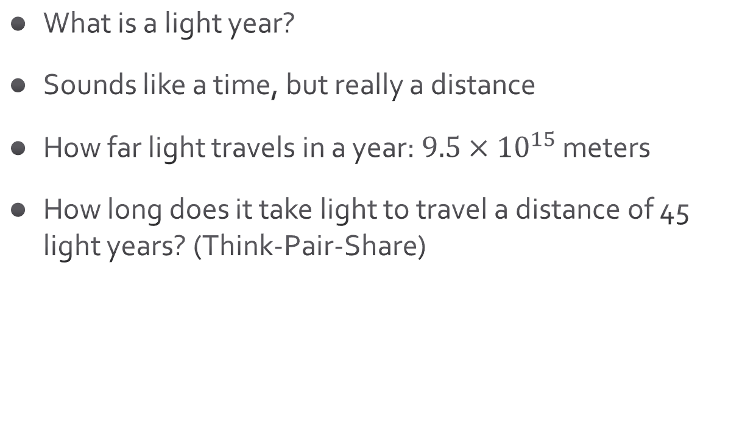
Light Year
What is a light year?
Sounds like a time, but really a distance
How far light travels in a year: $9.5×{10}^{15}$ meters
How long does it take light to travel a distance of 45 light years? (Think-Pair-Share)
Notes:
Ask for them to raise their hands.

Slide 7
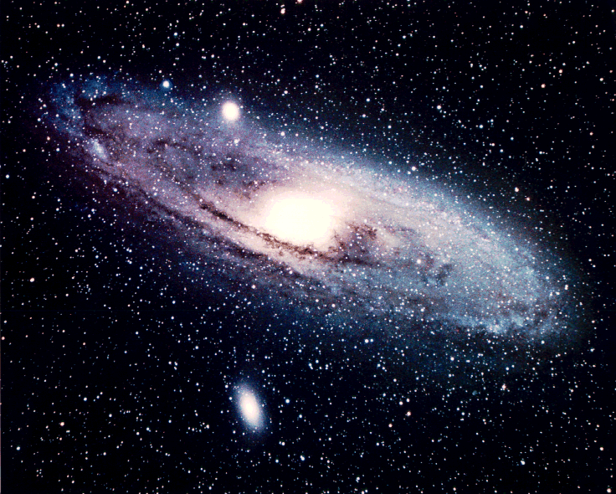
Andromeda (Cards)
The telescope image at the right was taken of the Andromeda Galaxy, which is located about 2.5 million light years away from us. Is this an image showing how the Andromeda Galaxy
  looks right now
  looked like in the past
  how it will look in the future?
Explain your reasoning.
Notes:
B; Use raising hand sequentially. Discuss advantages and disadvantages of this

Slide 8
Distant Star
Imagine that you are observing the light from a distant star that was located in a galaxy 100 million light years away from you. By analysis of the starlight received, you are able to tell that the image we see is of a 10 million year old star. You are also able to predict that the star will have a total lifetime of 50 million years, at which point it will end in a catastrophic supernova.
How long has it been since the star was born?
(Online Poll)
Notes:
110 million years old; hands on chest
https://www.polleverywhere.com/multiple_choice_polls/N1XrYsMAL5mNLyo2dQC7y
PollEV.com/steveturley298

Slide 9
Distant Star (Cards)
Imagine that you are observing the light from a distant star that was located in a galaxy 100 million light years away from you. By analysis of the starlight received, you are able to tell that the image we see is of a 10 million year old star. You are also able to predict that the star will have a total lifetime of 50 million years, at which point it will end in a catastrophic supernova.
How long will it be before we receive the light from the supernova event?
A. 150 million years
B. 50 million years
C. 40 million years
D. The right answer is not listed above.
Notes:
40mly, use cards

Slide 10
Distant Star (WB)
Imagine that you are observing the light from a distant star that was located in a galaxy 100 million light years away from you. By analysis of the starlight received, you are able to tell that the image we see is of a 10 million year old star. You are also able to predict that the star will have a total lifetime of 50 million years, at which point it will end in a catastrophic supernova.
Has the supernova already occurred? If so, how long ago?
Notes:
60 mya, use white boards
Discuss advantages
Comment—formative assessments can serve many purposes—they don’t have to give good summative information. An ambiguous question, or one built on bad assumptions can be a great question for prompting thinking and discussions

Slide 11
Timing
After reading or watching video but before class
Intermingled with learning activities
Application after instruction (homework)
Frequent
Could also be longer after the class

Slide 12
Characteristics
Low Stakes
Immediate
Tied to learning objectives
Tied to summative assessments

Slide 13
Ideas
Types
Pre-class quiz or essay (JiTT)
Quizzes which students can retake until they demonstrate mastery
Asking questions
Partner discussion
IClickers
Cards
Whiteboards
Fingers on chest
Quick Write
Interactive homework
Mid-course Evaluation

Slide 14
Ask yourself, “What am I trying to assess?”
The Montillation of Traxoline
It is very important that you learn about traxoline. Traxoline is a new form of zionter. It is montilled in Ceristanna. The Ceristannians gristerlate large amounts of fevon and then brachter it to quasel traxoline. Traxoline may well be one of our most lukized snezlaus in the future because of our zionter lescelidge.
(attributed to the insight of Judy Lanier)

Slide 15
The Montillation of Traxoline
It is very important that you learn about traxoline. Traxoline is a new form of zionter. It is montilled in Ceristanna. The Ceristannians gristerlate large amounts of fevon and then brachter it to quasel traxoline. Traxoline may well be one of our most lukized snezlaus in the future because of our zionter lescelidge.
Directions: Answer the following questions in complete sentences. Be sure to use your best handwriting.
1. What is traxoline?
2. Where is traxoline montilled?
3. How is traxoline quaselled?
4. Why is it important to know about traxoline?

Slide 16
Group Assessments
Many of the student-centered teaching strategies we’ve discussed rely on group and/or pair interactions
Alignment between learning outcomes, assessments, and learning activities
Examples of group assessments
  Advantages
  Disadvantages

Slide 17
Application
Design two formative assessments you will adopt in your planned course:
  Inform you about student mastery of a concept
  Inform your students about their mastery of a concept
Quick Write
  Take one minute to write down the main ideas from our discussion today that were insights you gained or ideas you will adopt about assessments.

